Slide 1


MDQ -Test Automation
Boot Camp 2016

Slide 2


Speakers
Finkbeiner, Walter
Globant - Test Automation Engineer
walter.finkbeiner@globant.com
Krzemien, Juan Pedro
Globant Technical Director
juan.krzemien@globant.com

Slide 3
Testing
The process of executing a program with the intention of certifying its quality
Is the process of operating a system or component to evaluate specific aspects under specific conditions, observing and registering the results.
Testing is the art of destroying something constructively

Slide 4
Testing
¿Why is it necessary?
Because errors exist...and humans **** up things. Testing helps us to:
Ensures product fits customer's requirements
Makes sure the code is reliable, helps improve developers knowledge/skills and overall product quality
Reduce defects that can potentially reach Production environments
Redefine the way things are done and how they work
Set projects up to success
As time passes, the cost of fixing a defect increases.

Slide 5
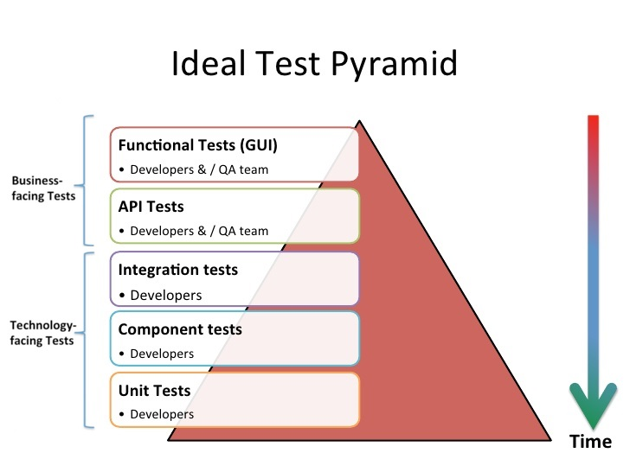
Testing Types

Slide 6
Testing Types
Unit tests
Exercises the smallest pieces of testable software (object or method) in the application to determine whether they behave as expected.
Executes against static code.
The developer that wrote the code is involved (+ Code Review).
Defects are fixed as soon as they are detected, without needing to go through the bug reporting formalities.
Coverage is measured in % of code covered.
Notes:
Written by developers. Test Automation Engineers may collaborate.

Slide 7
Testing Types
Component is any well-encapsulated, coherent and independently replaceable part of a larger system. In a microservice architecture, the components are the services themselves
Component tests
Limits the scope of the exercised software to a portion of the system under test, manipulating the system through internal code interfaces and using test doubles to isolate the code under test from other components.
Ability to thoroughly acceptance test the behavior encapsulated by that component
Tests execute more quickly than broad stack equivalents
Isolates component from its peers using test doubles. Avoids any complex behavior they may have
Controlled testing environment for the component. Able to trigger any applicable error cases in a repeatable manner
Notes:
Written by developers. Test Automation Engineers may collaborate.

Slide 8
Testing Types
Integration tests
Collect modules together and test them as a subsystem in order to verify that they collaborate as intended to achieve some larger piece of behavior. They check for any incorrect assumptions each module has about how to interact with its peers.
In micro service architectures they are typically used to verify interactions between layers of integration code and the external components to which they are integrating (other micro services, data stores and caches)
The goal is to verify that the module can communicate sufficiently rather than to acceptance test the external component
Should aim to cover basic success and error paths through the integration module
Notes:
Written by developers. Test Automation Engineers may collaborate.

Slide 9
Testing Types
End to End tests
Verifies that the system as a whole meets business goals irrespective of the component architecture in use. Since end-to-end tests are more business facing, they often utilise business readable Domain Syntax Language (DSL, such as Gherkin) to express test cases.
Written by Test Automation Engineers
Following guidelines usually applies to End to End tests:
Write as few as possible (specially UI tests, as they are the slowest type of automated test)
Make tests data-independent
Two different entry points for End to End tests
Web UI
Public APIs (“headless End to End”, without the UI)
Notes:
Written by Test Automation Engineers

Slide 10
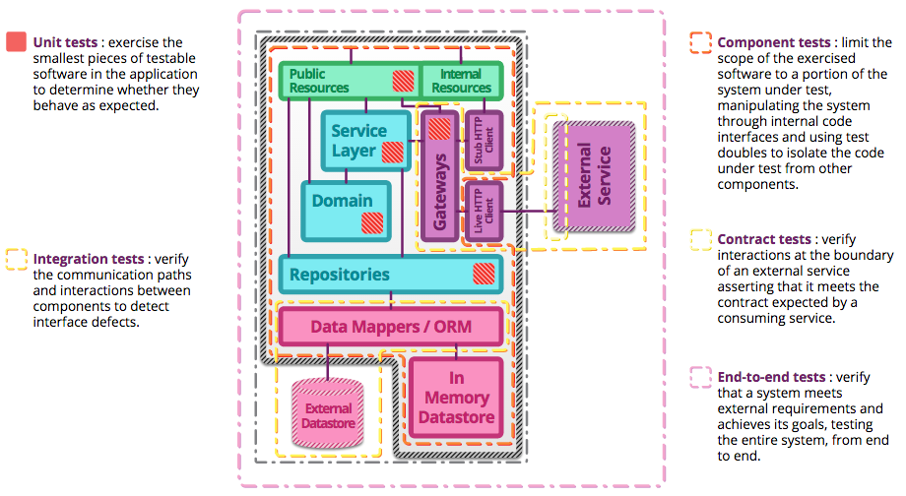
Testing Types

Slide 11
Testing Approaches
Approach | Purpose | Pros | Cons
Black Box | Tests what the software should do Based on the module’s definitions and specifications Does not care about the program’s internals Functional test, produced by data, inputs and outputs | Unbiased User based testing Requirement validation approach | Testing each/every input is unrealistic. Insufficient time. Many paths go untested Hard to evaluate how much has been tested Suites grow fast. High maintenance of automated tests Test redundancy
White Box | Tests what the software does Test cases are designed considering the software’s internal structure |  | Harder to validate requirements Development skills needed Cannot detect absence of functionality or misinterpretations
Positive | Verifies the ability of the system to implement a solution to the business needs under normal conditions
Negative | Verifies the ability of the system to detect, document and resolve user errors or any other condition not considered normal

Slide 12
Functional Testing Types
Generally described within the functional requirements specification
Refers mostly to “what the system does”
These tests belong to the “Black Box” category
Smoke testing: Refers to the first tests that are executed to provide quick feedback to determine if system under test is stable and won’t fail drastically
Sanity testing: Refers to the suite of tests that is executed to verify the main functions of a system are working without errors to determine if it is reasonable to continue with further (more detailed) tests
Regression testing: Consist in testing a system after a modification has taken place to verify that no new defects have been introduced or affected the previous correct functionality
Notes:
Smoke < Sanity < Many other feature specific suites < Regression (suite of suites, built/designed as frequently as per Sprint, with group of tests that are assumed to guarantee/verify modified areas of the system). Particularly in automation, every automated test makes the Regression suite.

Slide 13
Non Functional Testing Types
Tests system attributes that are not related to functionalities
May include:
Performance
Stress
Usability
Disaster/Error Recovery
Portability

